Slide 1
“Advice is a form of nostalgia. Dispensing it is a way of fishing the past from the disposal, and wiping it off, painting over the ugly parts, and recycling it for more than it’s worth.”
-Baz Luhrmann

Slide 2

The genomic era: powered by NGS

Slide 3
Fundamental biological questions
Selection
Connectivity

Slide 4

Evolutionary trajectory of species/populations
For population level inference, genome reduction is needed.

Slide 5
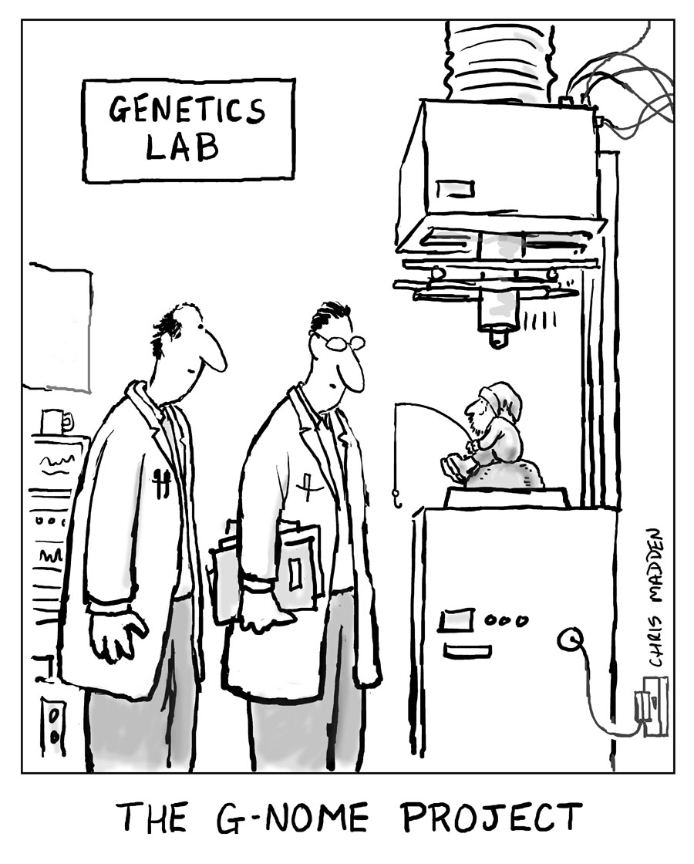
Genome reduction options
No existing genomic resources
RADseq
RNAseq
Exome capture?
EpiRAD
With genomic resources
Pool-seq
Low coverage WGS

Slide 6
Goals
Effectively work in a command-line Linux environment
Visualize and manipulate multiple next-generation sequencing data formats
Use and apply the tools and analyses covered in class
Knowledgeably filter data sets for statistical and bioinformatic artifacts
Determine loci potentially under selection and estimate population genetic parameters with both neutral and putatively adaptive loci
Produce a completely open and repeatable documentation of a complete population genomic analysis

Slide 7
Syllabus and Course Repository
https://github.com/jpuritz/BIO_594_2019

Slide 8
Goals for today
Setup your personal computer for ssh
Setup an RSA key for sshing into the class server
Clone the class git repository to both your server account
Test out terminal functionality in RStudio

Slide 9
Final thought of the day...

